Slide 1

Process Models
Dr Frank Jiang
Email： Frank.Jiang@deakin.edu.au
Wechat (微信): ming814100501
Lecture

Slide 2
Project Management Spectrum
The 4 P’s
People — the most important element of a successful project
Product — the software to be built
Process — the set of framework activities and software engineering tasks to get the job done
Project — all work required to make the product a reality
Notes:
Software engineering is the application of engineering to the development of software in a systematic method
the systematic application of scientific and technological knowledge, methods, and experience to the design, implementation, testing, and documentation of software"—The Bureau of Labor Statistics—IEEE Systems and software engineering - Vocabulary^{[4]}

Slide 3
SE - A Layered Technology
Software Engineering
Software Engineering
tools
methods
process model
a “quality” focus
A “quality” focus is an organizational commitment to quality
“Software process” is a road map that you follow to build a product or system.
Notes:
Quality is how it is supposed to be – In theory
Quality focus is really the TONE of the project, the tone/attitude of a business
always trickles down from the leadership. If leadership is committed to
quality, that will influence the minions.
What happens if you change the foundation from quality to something else?
Profit? Latest Version? Deadline
Process – more than just order of events
Determines: deadlines, milestones, all expected output
Methods – how will you gather requirements
how will you design the software UML, Jackson, Gane-sarson
how will you test the software etc.
Tools – Automated support
auto code generation WYSIGYG
auto code completion
FOCUS: Process

Slide 4
Why Process?
Process model defines a series of predictable steps to help you create a timely, high quality result.
Although IDEAL model defines a problem solving stages, how to implement these stages still depends on the software your are building.
Process model provides a road map for building software.
In general, process models try to bring order into software development
Notes:
Process is a map
It helps you figure out where you are, where you are going and how to get
there.
What towns (phases) you will pass through,
How long to get to the next town (deadlines/time estimates),
Identify hazadarous/distracting paths (loss of focus, dabbling outside of scope)
What products and services (deliverables) are available in the next town
What your final destination is (project completion)
Analyze your trip $/gallon of gasoline (project review)

Slide 5
Generic Process Framework Activities
Communication
Planning
Modeling
  Analysis of requirements
  Design
Construction
  Code generation
  Testing
Deployment
How to implement these activities, or how to organize these activities into process models?
Notes:
Bare minimums baring cancellation
Communication. Unless it is a 1 person thing for personal use you will discuss with others.
Planning, phases, management plans, definition of success,
Most important
Modeling
2nd most important

Slide 6
The Process Model: Adaptability
Hopefully the framework activities will always be applied on every project ... BUT ☹
the tasks (and degree of rigor) for each activity will vary based on:
  Characteristics which determine the type of project
    Iterative
    Completely new technology being developed
    Size
  common sense judgment/experience
  concurrence of the project team
    Sense of commitment
Notes:
Just like the state of an object is determined by its attribute values the type of project is determined by its characteristics
Common sense isn’t common

Slide 7

Waterfall Model
Notes:
Advantages: Works for small projects

Slide 8
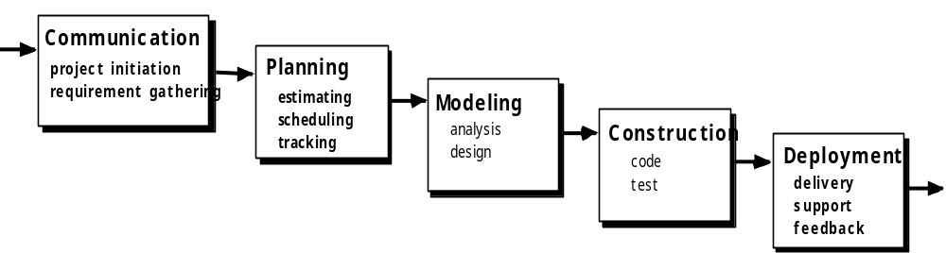
Waterfall Model
Also called Classic Life Cycle. The oldest model for SE.
Disadvantages: unclear requirements, error propagation, blocking state, only works for small projects, etc…
No Project can avoid going backwards and forwards a little bit.
Notes:
Advantages: Works for small projects
Disadvantages dependecies

Slide 9
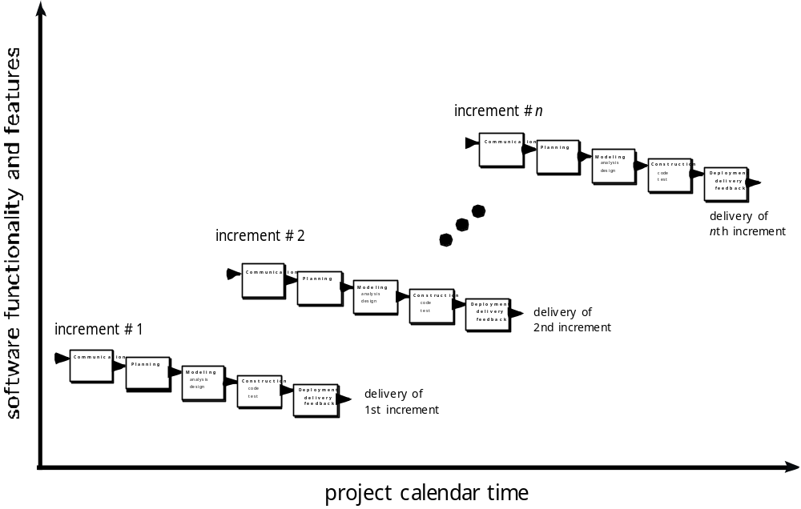
Incremental Model
Combines Waterfall model elements in an iterative fashion
Applies linear sequences in a staggered fashion as calendar time progresses
Core Product
Notes:
Adding functions and calls to databases.
Adding features to a word processor

Slide 10
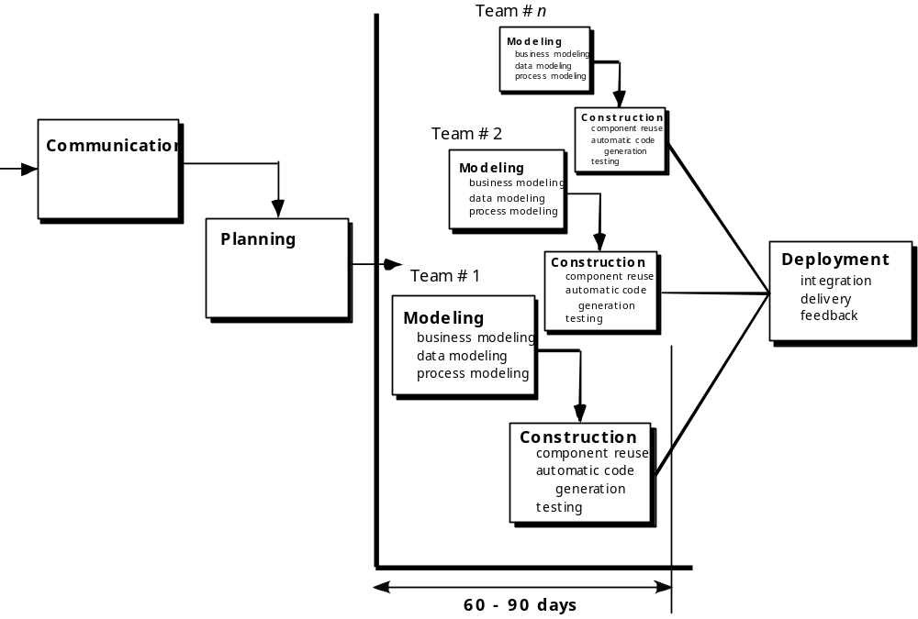
Incremental:
Rapid Application Development (RAD) Model
Notes:
Also incremental
3 month max development time
Requirements need to be well understood
Uses multiple teams and lots of resources and commitment
Re-uses existing software

Slide 11

Evolutionary Models: Prototyping
Iterative Models: Prototyping
The prototype usually will be thrown away
Used to assist the software engineer and the customer to better understand what is to be built when requirements are fuzzy
Notes:
Software does not evolve. It is purposefully design, evolution is random changes to reproducing beings. Software generally is not reproductive.
All evolution based programs start with a set of functions that have pre-defined and are selected based on success. Evolution didn’t start with pre-defined functions.
Don’t understand requirements
Expensive
Takes time
Prototype may not actually work, but just be an interface

Slide 12
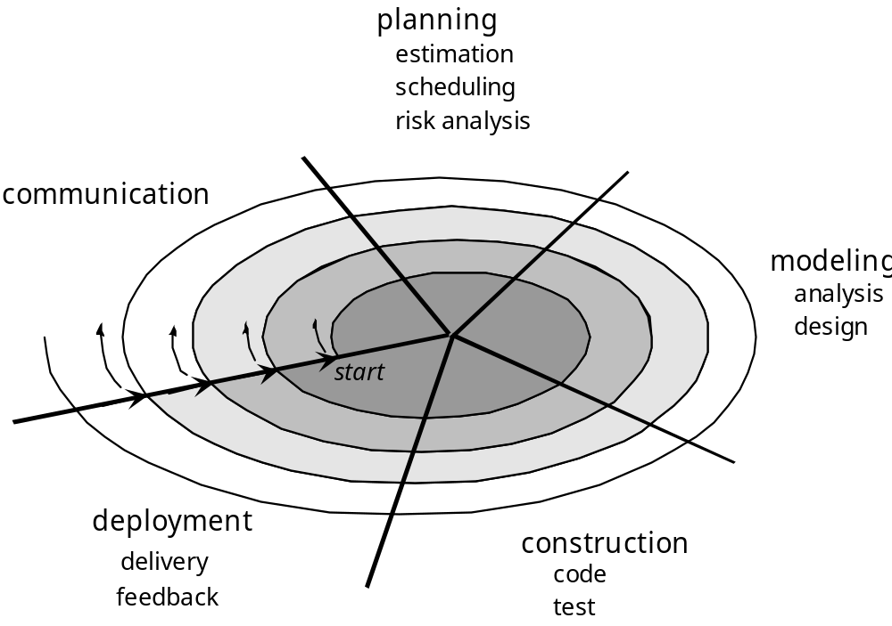
Iterative Models: The Spiral
Usually for development of increasingly more complete versions of the software
Spiral model can be adapted to apply throughout the life of the computer software
Notes:
Difference between spiral and Prototyping
Prototyping should have a given life span. Predefined number of iterations.
Spiral can be continuous
No major difference

Slide 13
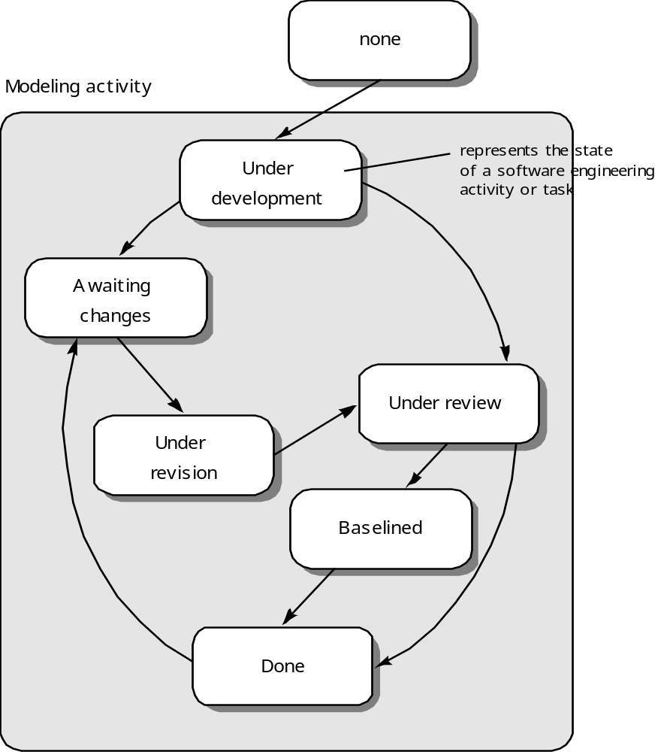
Iterative Models: Concurrent
Recognizes that different part of the project (e.g. Modeling in this diagram) will be at different places in the process
Word Processor example: Implement spell checking, Grammar check and Page numbering function
Notes:
Each box could be a sub-state in the incremental model

Slide 14
Iterative Models: Summary
Versioning and Iteration
  How many versions of MS Office have existed?
  Starting way back on Windows 3.11
Software does not evolve
  All forms of software have only come into existence due to purpose
  Evolution requires reproduction, software doesn’t reproduce itself
Learning Model

Slide 15
Other Process Models
Component assembly model – Re-use
Formal methods - the process to apply when a mathematical specification is to be developed
  P(X,Y,S) = e_{s1} (k₁, p₁)* Σ t_{si}(s_{i}+1)*e_{si+1}(k_{i+1}, p_{i+1})
  _{Specific to general}

Slide 16
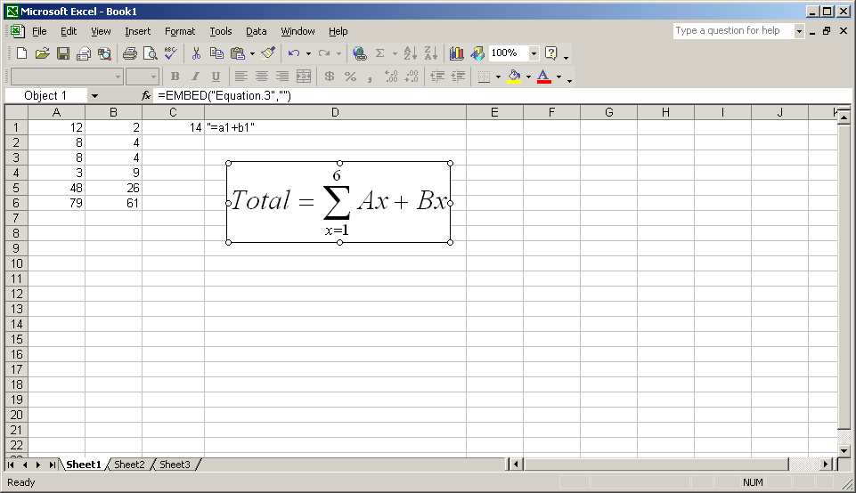
Formal Models: Specific to General

Slide 17
Other Process Models
Component assembly model – Re-use
Formal methods - the process to apply when a mathematical specification is to be developed
  P(X,Y,S) = e_{s1} (k₁, p₁)* Σ t_{si}(s_{i}+1)*e_{si+1}(k_{i+1}, p_{i+1})
  _{Specific to generalization}
Cleanroom software engineering – emphasizes error detection before testing
Unified process – for OO software engineering using UML
Agile process models – focuses on self-organized teams; communication and collaboration; rapid response to changes; rapid delivery of software.

Slide 18
Summary
Software Process Models
  Why process model
  Software process models
    Waterfall model
    Incremental model
    RAD (rapid application development) model
    Prototyping model
    Spiral model
    Concurrent
    Others
  When to use
Notes:
Many criteria to consider:
Time
Group members and their commitment
Money and resources
Requirements known?
Expectation of versions
Software lifespan

Slide 19
Summary
Questions?
Notes:
Many criteria to consider:
Time
Group members and their commitment
Money and resources
Requirements known?
Expectation of versions
Software lifespan

Slide 20
Readings
Pressman (6th ed.), Chapter 2 and Chapter 3
OR
Pressman (5th ed.), Chapter 2.

